Slide 1

Gulf Coast Emergency Migration + Management
Al-Jalil Gault | Andrew Renninger | Cloud Computing + Visualization
Illustration: Sarah Grillo/Axios

Slide 2
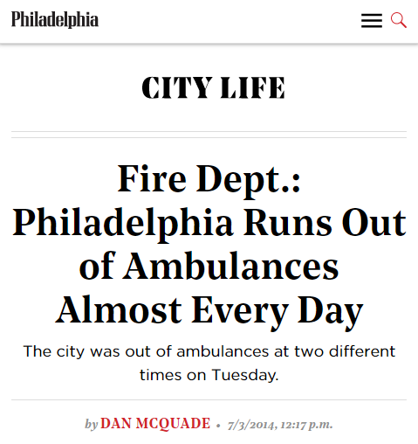
Delays in Emergency Medical Services are an Imminent Threat
A Study of North Los Angeles County, found that 14.8% of EMS calls were delayed.
The average time of the delay was 35 mins.
Photo: Aftermath of Hurricane Delta, Creole, Louisiana Oct 2020

Slide 3
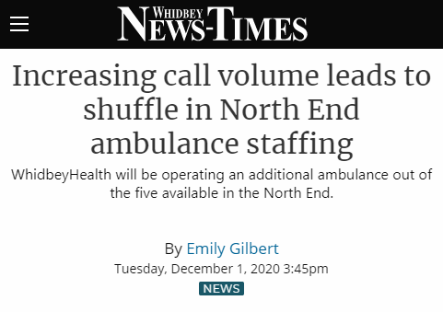
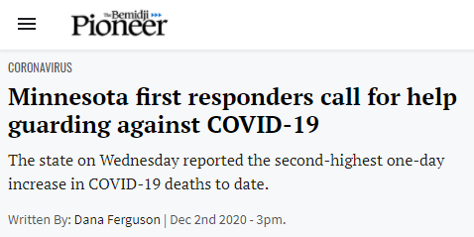
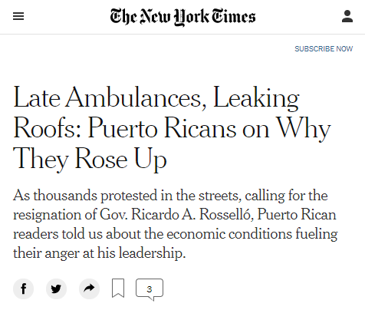
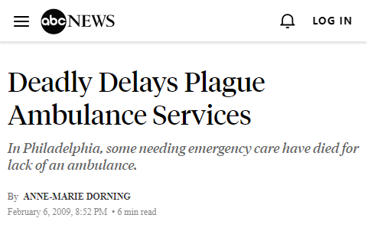
We Must Plan for Adjustments

Slide 4
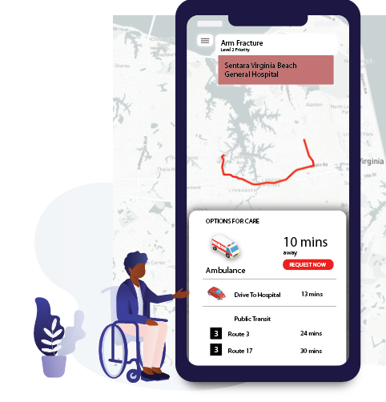
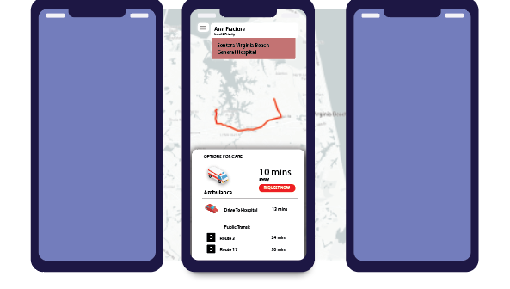
Knowledge for those in need:
An easy-to-use App
Select priority incident, decide on services,
Conduct telemedicine visit

Slide 5
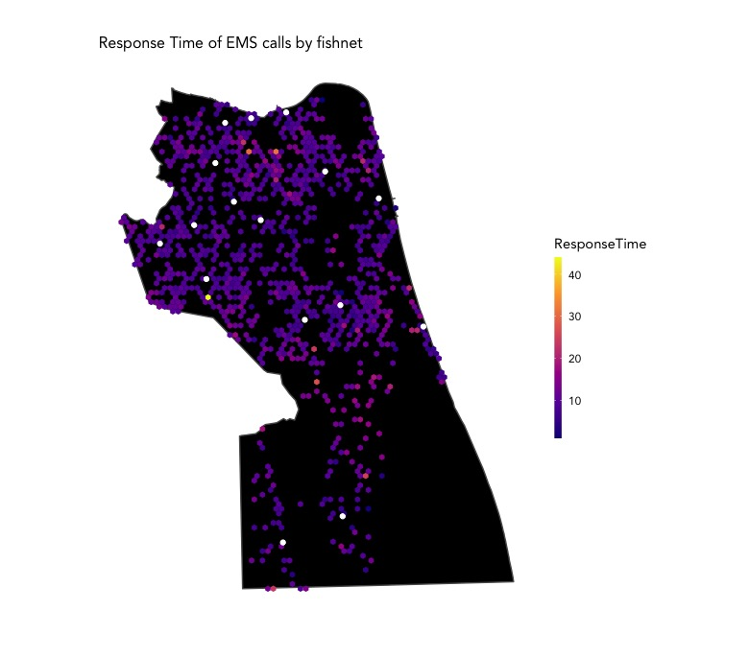

How do we know?

Slide 6
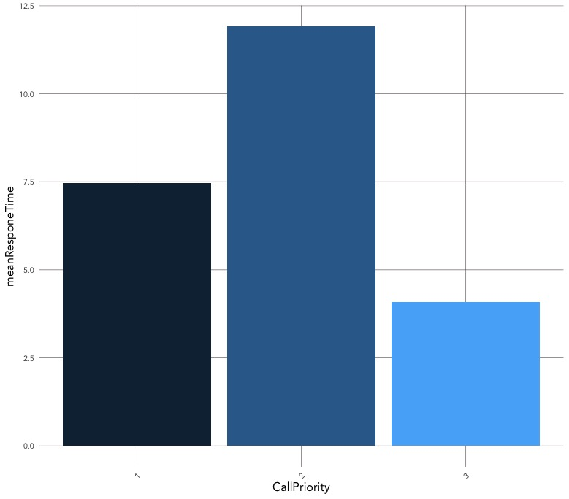
Patterns from
Historical Calls
Incident Priority
Priority 2 incidents have the longest response time
Priority 1 – life threatening, salvageable
Head injuries
Severe burns
Heart attack
Breathing impaired
Internal injuries
Priority 2 – Moderate/Serious injury, not life threatening
Fractures
Post-stroke, but stable
Altered mental status
Priority 3 – “Walking Wounded”,

Slide 7
Patterns from
Historical Calls
Time of Day, Day of Week

Slide 8
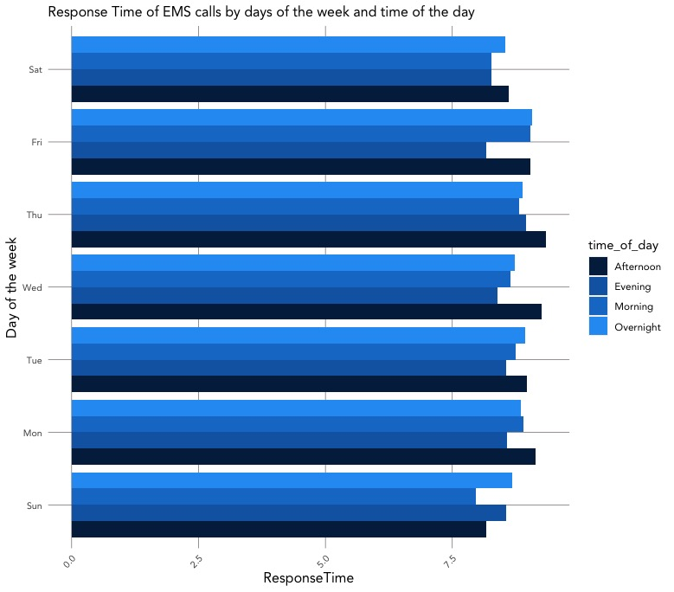
Patterns from
Historical Calls
Time of Day, Day of Week
Afternoon and morning Calls have the longest wait times

Slide 9
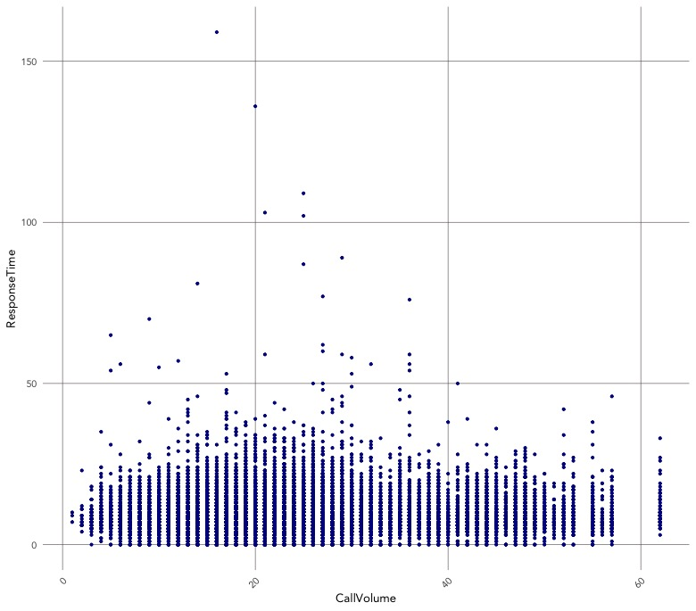
Patterns from
Historical Calls
Volume of Calls
Peak wait times are related to call volume

Slide 10
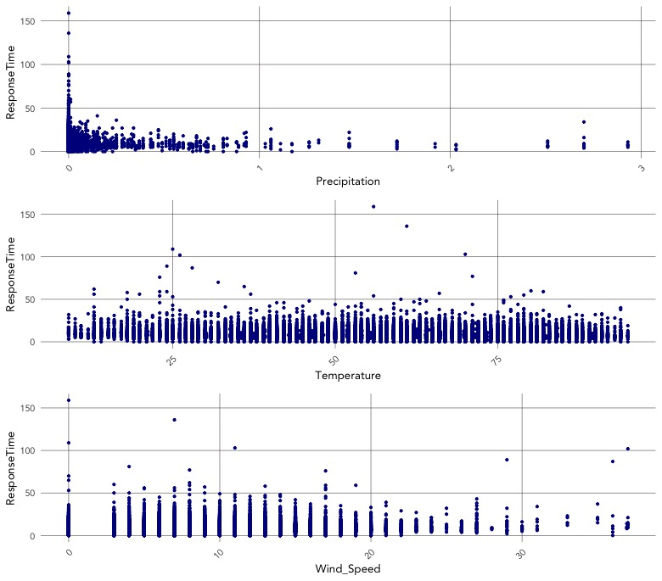
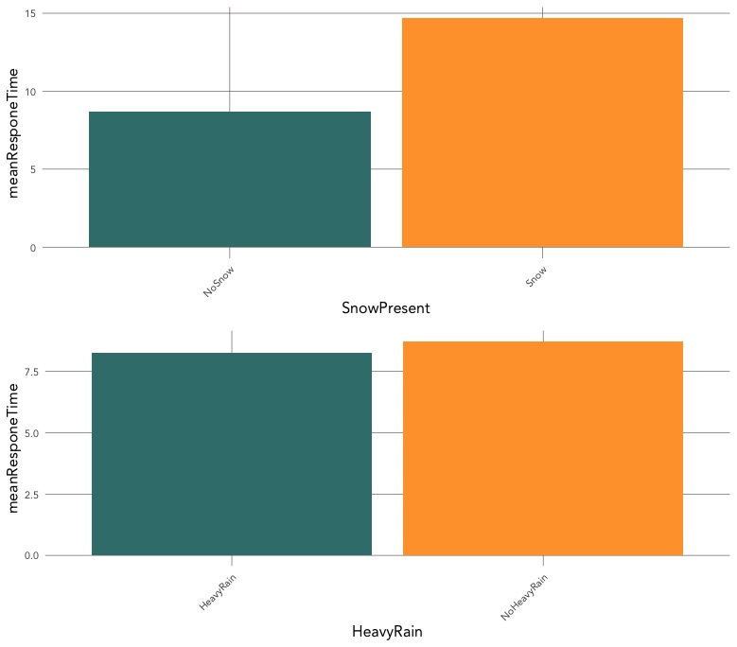
Patterns from
Historical Calls
Weather
Snowy days have longer wait times

Slide 11
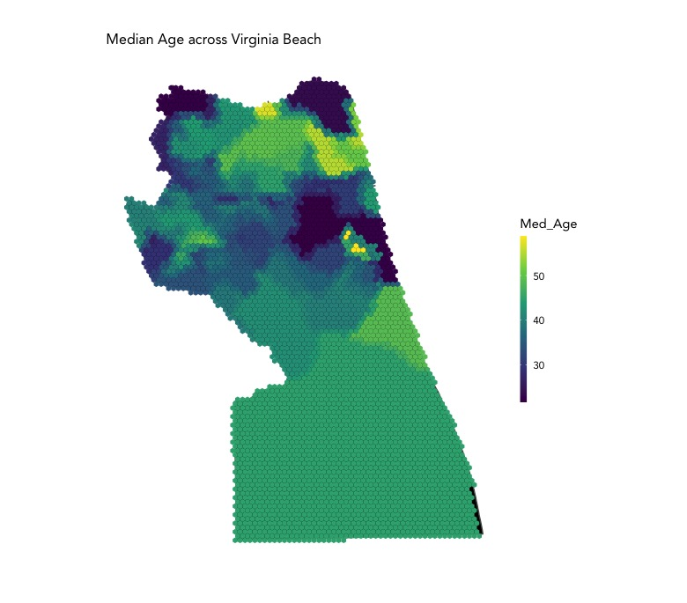
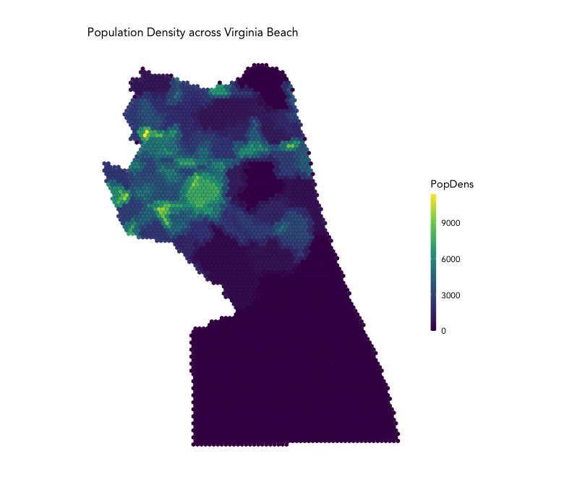
Patterns from
Historical Calls
Population
Areas with Older Populations have longer wait times

Slide 12

Questions ?
Al-Jalil Gault | DVRPC | Office of Energy and Climate Change Initiatives
Photo: Philadelphia Energy Company Outreach

